Slide 1
Day1 – Measures of Central Tendency, Spread and Shape

Slide 2
Measures of CT, Dispersion and Shape
Learning Objective
Study of Central Tendency, Measures of Variability, Measures of Shape
Mean, Median, Mode, Quartile, Percentile
Range, Variance, Standard Deviation
Skewness Kurtosis

Slide 3
Measures of Central Tendency
Measures of central tendency yield information about locations in a group of data points
Common Measures of Location
Mode
Median
Mean
Percentiles
Quartiles

Slide 4

Mean
Properties
Mean is the average of a group of numbers
Applicable for interval and ratio data *
Not applicable for nominal or ordinal data *
Affected by each value in the data set, including extreme values
Computed by summing all values in the data set and dividing the sum by the number of values in the data set
Mathematically

Slide 5
Median
Properties
Middle value in an ordered array of numbers.
Half the data are above it, half the data are below it
Mathematically, it’s the (n+1)/2 ^{th} ordered observation
For an array with an odd number of terms, the median is the middle number
n=11 => (n+1)/2 ^{th} = 12/2 ^{th} = 6th ordered observation
For an array with an even number of terms the median is the average of the middle two numbers
n=10 => (n+1)/2 ^{th} = 11/2 ^{th} = 5.5th = average of 5th and 6th ordered observation

Slide 6
Mode
Properties
The most frequently occurring value in a data set
Applicable to all levels of data measurement (nominal, ordinal, interval, and ratio)
Can be used to determine what categories occur most frequently
Sometimes, no mode exists (no duplicates)
Bimodal – In a tie for the most frequently occurring value, two modes are listed
Multimodal - Data sets that contain more than two modes

Slide 7

Percentiles
Properties
Measures of central tendency that divide a group of data into 100 parts
At least n% of the data lie at or below the n^{th} percentile, and at most (100 - n)% of the data lie above the n^{th} percentile
Example: 90th percentile indicates that at 90% of the data are equal to or less than it, and 10% of the data lie above it
Mathematically

Slide 8
Quartiles
Properties
Measures of central tendency that divide a group of data into four subgroups
Q1: 25% of the data set is below the first quartile
Q2: 50% of the data set is below the second quartile
Q3: 75% of the data set is below the third quartile

Slide 9
Variability/Dispersion
Properties
Measures of Variability describe the spread or the dispersion of a set of data.
Provides more meaningful data when used
With measures of central tendency
in comparison to other groups
Measures of Variability
Range
Inter-quartile Range
Mean Absolute Deviation
Variance and Standard Deviation
Coefficient of Variation

Slide 10
Range
Properties
The difference between the largest and the smallest values in a set of data
Advantage – easy to compute
Disadvantage – is affected by extreme values
Mathematically = Range = Highest - Lowest
Interquartile Range
Properties
Range of values between the first and third quartiles
Range of the “middle half”; middle 50%
Useful when researchers are interested in the middle 50%, and not the extremes
Mathematically
IQR = Q3-Q1

Slide 11
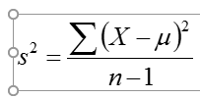
Variance
Properties
Average of the squared deviations from the arithmetic mean, Denoted by S²
^{Mathematically}
^{Standard Deviation}
^{Properties}
Standard deviation is the square root of the sample variance
Same units as original data
Standard Deviation is = Sqrt(Variance)

Slide 12
Range
Properties
The difference between the largest and the smallest values in a set of data
Advantage – easy to compute
Disadvantage – is affected by extreme values
Mathematically = Range = Highest - Lowest
Interquartile Range
Properties
Range of values between the first and third quartiles
Range of the “middle half”; middle 50%
Useful when researchers are interested in the middle 50%, and not the extremes
Mathematically
IQR = Q3-Q1

Slide 13
Variance
Properties
Average of the squared deviations from the arithmetic mean. Denoted by S²
^{Mathematically}
^{Standard Deviation}
^{Properties}
Standard deviation is the square root of the sample variance
Same units as original data

Slide 14
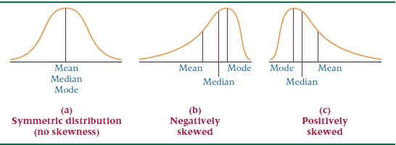
Shape
Properties
Measures of shape are tools that can be used to describe the shape of a distribution of data.
Symmetrical: Right half is a mirror image of the left half
Asymmetrical/Skewed – Shows that the distribution lacks symmetry;
Used to denote the data is sparse at one end, and piled at the other end
Positively- or right-skewed
Negatively- or left-skewed
Coefficient of Skewness (S_{k})
Compares the mean and median in light of the magnitude to the standard deviation

Slide 15
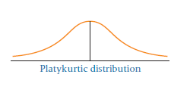
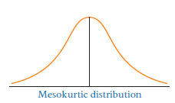
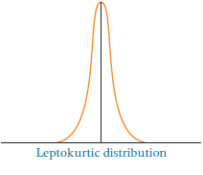
Kurtosis
Kurtosis describes the amount of peakedness of a distribution.

Slide 16
Day2 – Data Visualization

Slide 17
Data Visualization
Learning Objectives
Construct a frequency distribution for both grouped and ungrouped data
Construct graphical summaries of qualitative data
Construct graphical summaries of quantitative data

Slide 18
Ungrouped Versus Grouped Data
Ungrouped data
have not been summarized in any way
are also called raw data
Grouped data
logical groupings of data exists
i.e. age ranges (20-29, 30-39, etc.)
have been organized into a frequency distribution

Slide 19
Frequency Distribution
Frequency Distribution – summary of data presented in the form of class intervals and frequencies
- It Vary in shape and design
- It is constructed according to the individual researcher's preferences
Steps in Frequency Distribution
Step 1 - Determine range of frequency distribution
- Range is the difference between the high and the lowest numbers
Step 2 - Determine the number of classes
- Don’t use too many, or two few classes
Step 3 - Determine the width of the class interval
- Approx class width can be calculated by dividing the range by the number of classes
- Values fit into only one class

Slide 20
Frequency Distribution
Class Mid point - The Midpoint of each class interval
Relative Frequency - It is the proportion of the total frequency that is in any given class interval in a frequency distribution.
Cumulative Frequency - It is a running total of frequencies through the classes of a frequency distribution.
Example : The following data are the average weekly mortgage interest rates for a 40-week period.
Data _ Sheet 1
Construct a frequency distribution for these data. Calculate and display the
class midpoints, relative frequencies, and cumulative frequencies for this frequency distribution.

Slide 21
Frequency Distribution
Solution : How many classes should this frequency distribution contain?
The range of the data is 1.33 (7.68–6.35). If 7 classes are used, each class width is approximately:
Class width = Range / Number of Classes = 1.33 / 7 = 0.19
If a class width of .20 is used, a frequency distribution can be constructed with endpoints that are more uniform looking and allow presentation of the information in categories more familiar to mortgage interest rate users.

Slide 22
Frequency Distribution
Solution : How many classes should this frequency distribution contain?
The range of the data is 1.33 (7.68–6.35). If 7 classes are used, each class width is approximately:
Class width = Range / Number of Classes = 1.33 / 7 = 0.19
If a class width of .20 is used, a frequency distribution can be constructed with endpoints that are more uniform looking and allow presentation of the information in categories more familiar to mortgage interest rate users.

Slide 23
Frequency Distribution
The first class endpoint must be 6.35 or lower to include the smallest value; the last endpoint must be 7.68 or higher to include the largest value. In this case the frequency distribution begins at 6.30 and ends at 7.70. The resulting frequency distribution, class midpoints, relative frequencies, and cumulative frequencies are listed in the Excel sheet 1.
The frequencies and relative frequencies of these data reveal the mortgage interest rate classes that are likely to occur during the period. Most of the mortgage interest rates (36 of the 40) are in the classes starting with 6.70–under 6.90 and going through 7.30–under 7.50. The rates with the greatest frequency, 13, are in the 7.10-under 7.30 class.

Slide 24
Frequency Distribution
Exercise : The following data represent the afternoon high temperatures for 50 construction days during a year in St. Louis.
Data _ Excel Sheet2
a. Construct a frequency distribution for the data using five class intervals.
b. Construct a frequency distribution for the data using 10 class intervals.
c. Examine the results of (a) and (b) and comment on the usefulness of
the frequency distribution in terms of temperature summarization
capability.

Slide 25
Frequency Distribution
Common Statistical Graphs – Quantitative Data
Histogram - Vertical bar chart of frequencies
Frequency Polygon - Line graph of frequencies
Ogive - line graph of cumulative frequencies
Stem and Leaf Plot - Like a histogram, but shows individual data values. Useful for small data sets.
Pareto Chart - type of chart which contains both bars and a line graph.
- The bars display the values in descending order, and the line graph shows the cumulative totals of each category, left to right.
- The purpose is to highlight the most important among a (typically large) set of factors.

Slide 26
Frequency Distribution
Histogram
Interval Frequency
20-under 30 6
30-under 40 18
40-under 50 11
50-under 60 11
60-under 70 3
70-under 80 1

Slide 27
Frequency Distribution
Frequency Plot
Interval Frequency
20-under 30 6
30-under 40 18
40-under 50 11
50-under 60 11
60-under 70 3
70-under 80 1

Slide 28
Frequency Distribution
Ogive
Interval Cumulative Frequency
20-under 30 6
30-under 40 24
40-under 50 35
50-under 60 46
60-under 70 49
70-under 80 50

Slide 29
Frequency Distribution
Stem and Leaf plot: Safety Examination Scores for Plant Trainees
Raw Data
Stem
Leaf
86
77
91
60
55
2
3
4
5
6
7
8
9
3
9
7 9
5 6 9
0 7 7 8 8
0 2 4 5 5 6 7 7 8 9
1 1 2 3 3 6 8 9
1 1 2 4 7
76
92
47
88
67
23
59
72
75
83
77
68
82
97
89
81
75
74
39
67
79
83
70
78
91
68
49
56
94
81

Slide 30
Frequency Distribution
Common Statistical Graphs – Qualitative Data
Pie Chart - A pie chart is a circular depiction of data where the area of the whole pie represents 100% of the data and slices of the pie represent a percentage breakdown of the sublevels.
Bar Chart - Frequency or relative frequency of one more categorical variables
Pareto charts - A graphical technique for displaying problem causes is Pareto analysis. Pareto analysis is a quantitative tallying of the number and types of defects that occur with a product or service. Analysts use this tally to produce a vertical bar chart that displays the most common types of defects, ranked in order of occurrence from left to right. The bar chart is called a Pareto chart.
Scatter Plot - A scatter plot is a two-dimensional graph plot of pairs of points from two numerical variables.

Slide 31
Frequency Distribution
COMPLAINT
NUMBER
PROPORTION
DEGREES
Stations, etc.
28,000
.40
144.0
Train
14,700
.21
75.6
Performance
Equipment
10,500
.15
50.4
Personnel
9,800
.14
50.6
Schedules,
7,000
.10
36.0
etc.
Total
70,000
1.00
360.0

Slide 32
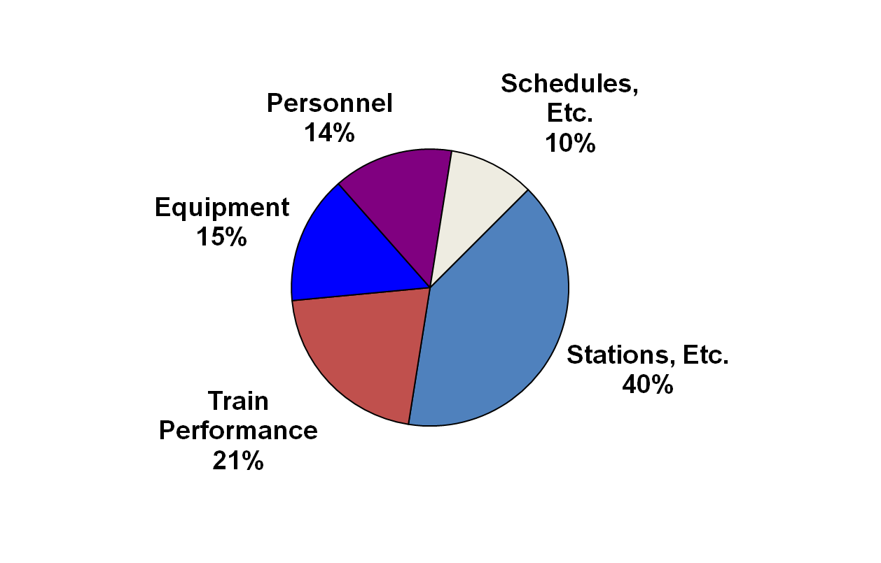
Frequency Distribution
Pie Chart

Slide 33
Frequency Distribution
Scatter Plot
Registered Vehicles (1000's) | Gasoline Sales (1000's of Gallons)
5 | 60
15 | 120
9 | 90
15 | 140
7 | 60

Slide 34
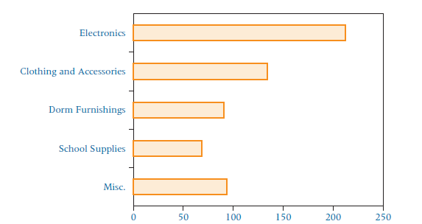
Frequency Distribution
Bar Plot
Category | Amount
Electronics | 211.89
Clothing and Accessories | 134.4
Dorm Furnishings | 90.9
School Supplies | 68.47
Misc. | 93.72

Slide 35
Frequency Distribution
Excercise :
1. For the following data, construct a frequency distribution with six classes.
2. Construct a scatter plot for the following two numerical
variables.
Data for Excercise

Slide 36
Day3 – Probability Concepts and Applications

Slide 37
Probability Concepts and Applications
Learning Objective
Understanding of probability, Marginal, Union, Joint, and conditional probabilities.
Laws of probability, Addition, Multiplication and Conditional probability
Bayes Theorem

Slide 38
Introduction
Probability of occurrences are assigned to the inferential process under conditions of uncertainty - Explain
Key Terminology
Experiment
Event – an outcome of an experiment
Elementary event
Sample Space
Trial
Structure of Probability
Mutually Exclusive Events
Independent Events
Collectively Exhaustive Events
Complementary Events

Slide 39
Four Types of Probability
Marginal
Union
Joint
Conditional
The probability of X occurring
The probability of X or Y occurring
The probability of X and Y occurring
The probability of X occurring given that Y has occurred
X
X
Y
X
Y
Y

Slide 40
Laws of Probability
Addition
Multiplication
Conditional Probability

Slide 41
Bayes Rule
Properties
An extension to the conditional law of probabilities
Allows for reversing the order of conditioning
The denominator is a collective exhaustive listing of mutually exclusive outcomes of Y
The denominator is a weighted average of the conditional probabilities with the weights being the prior probabilities of the corresponding event

Slide 42
Case 1
Purchasing Survey asked purchasing professionals what sales traits impressed them most in a sales representative. Seventy-eight percent selected “thoroughness.” Forty percent responded “knowledge of your own product.” The purchasing professionals were allowed to list more than one trait. Suppose 27% of the purchasing professionals listed both “thoroughness” and “knowledge of your own product” as sales traits that impressed them most. A purchasing professional is randomly sampled.
What is the probability that the professional selected “thoroughness” or “knowledge of your own product”?
b. What is the probability that the professional selected neither “thoroughness” nor “knowledge of your own product”?
c. If it is known that the professional selected “thoroughness,” what is the probability that the professional selected “knowledge of your own product”?
d. What is the probability that the professional did not select “thoroughness” and did select “knowledge o your own product”?

Slide 43
Case 2
The U.S. Bureau of Labor Statistics publishes data on the benefits offered by small companies to their employees. Only 42% offer retirement plans while 61% offer life insurance. Suppose 33% offer both retirement plans and life insurance as benefits. If a small company is randomly selected, determine the following probabilities:
a. The company offers a retirement plan given that they offer life insurance.
b. The company offers life insurance given that they offer a retirement plan.
c. The company offers life insurance or a retirement plan.
d. The company offers a retirement plan and does not offer life insurance.
e. The company does not offer life insurance if it is known that they offer a retirement plan.

Slide 44
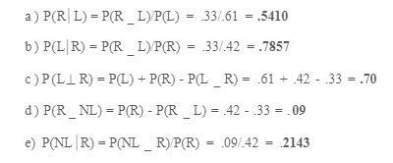

Slide 45
Associate Analytics Program – Day 4 & 5
Discrete Distributions
Learning Objectives
Distinguish between discrete random variables and continuous random variables.
Know how to determine the mean and variance of a discrete distribution.
Identify the type of statistical experiments that can be described by the binomial distribution, and know how to calculate probabilities based on the binomial distribution.

Slide 46
Discrete Distribution
Discrete vs. Continuous Distributions :
Random Variable - a variable which contains the outcomes of a chance experiment
Discrete Random Variable - A random variable that only takes on distinct values
ex: Number of heads on 10 flips, Number of defective items in a random sample of 100, Number of times you check your watch during class, etc.
Continuous Random Variable - A random variable that takes on infinite values by increasing precision. For each two values, there always exists a valid value in between them.
ex: Time until a bulb goes out, height, etc.

Slide 47
Discrete Distribution
Descrbing a Distribution :
A distribution can be described by constructing a graph of the distribution
Measures of central tendency and variability can be applied to distributions
Mean of discrete distribution - is the long run average
If the process is repeated long enough, the average of the outcomes will approach the long run average (mean)
Mean of a discrete distribution
µ = ∑ (Xi * P(Xi))
where µ is the long run average,
Xi = the ith outcome

Slide 48
Discrete Distribution
Descrbing a Distribution :
Variance of a discrete distribution is obtained in a manner similar to raw data, summing the squared deviations from the mean and weighting them by P(Xi) (rather than dividing by n):
Var(Xi) = ∑ ((Xi – m)2* P(Xi))
Standard Deviation is computed by taking the square root of the variance

Slide 49
Discrete Distribution
Discrete Distribution Example :
An executive is considering out-of-town business travel for a given Friday. At least one crisis could occur on the day that the executive is gone.
The distribution on the following slide contains the number of crises that could occur during the day the executive is gone and the probability that each number will occur. For example, there is a .37 probability that no crisis will occur, a .31 probability of one crisis, and so on.

Slide 50
Discrete Distribution
Discrete Distribution Example :
.
P
r
o
b
a
b
i
l
i
t
y
0.5
Distribution of Daily Crises
0.4
Number of Crises
Probability
0.3
0
1
2
3
4
5
0.37
0.31
0.18
0.09
0.04
0.01
0.2
0.1
0
0
1
2
3
4
5
Number of Crises

Slide 51
Discrete Distribution
Mean & SD of Discrete Distribution :
.
# Crises (X) | Prob (P) | XP | X-μ | (X-μ)² | (X-μ)²P
0 | 0.37 | 0 | -1.15 | 1.32 | 0.49
1 | 0.31 | 0.31 | -0.15 | 0.02 | 0.01
2 | 0.18 | 0.36 | 0.85 | 0.72 | 0.13
3 | 0.09 | 0.27 | 1.85 | 3.42 | 0.31
4 | 0.04 | 0.16 | 2.85 | 8.12 | 0.32
5 | 0.01 | 0.05 | 3.85 | 14.82 | 0.15
SUM: | 1 | 1.15 | 8.1 | 28.44 | 1.41

Slide 52
Discrete Distribution
Requirements for a Discrete Probability Function :
.
Each probability must be between 0 and 1
The sum of all probabilities must be equal to 1.
X
P(X)
X
P(X)
X
P(X)
-1
0
1
2
3
.1
.2
.4
.2
.1
1.0
-1
0
1
2
3
-.1
.3
.4
.3
.1
1.0
-1
0
1
2
3
.1
.3
.4
.3
.1
1.2
VALID
NOT VALID
NOT VALID

Slide 53
Discrete Distribution
Binomial Distribution :
The binomial distribution is a discrete distribution where X is the number of “successes” and the following four conditions are met:
There are n trials
The n trials are independent of each other
The outcome is dichotomous – only two outcomes possible
The probability of “success” is constant
Example, 10 coin flips, X = # of heads
X = the number of “successes” and we say X follows a Binomial distribution with n trial and P(success) = p
If the data follow a binomial distribution, then we can summarize P(Xi) for all values of Xi = 1, …, n through the binomial probability distribution formula

Slide 54
Discrete Distribution
Binomial Distribution :
.
Probability function
Mean value
Variance and Standard Deviation

Slide 55
Discrete Distribution
Binomial Distribution :
Example : According to the U.S. Census Bureau, approximately 6% of all workers in Jackson, Mississippi, are unemployed. In conducting a random telephone survey in Jackson, what is the probability of getting two or fewer unemployed workers in a sample of 20?
In this example,
6% are unemployed => p
The sample size is 20 => n
94% are employed => q
X is the number of successes desired
What is the probability of getting 2 or fewer unemployed workers in the sample of 20? => P(X≤2)
The hard part of this problem is identifying p, n, and x – emphasize this when studying the problems.

Slide 56
Discrete Distribution
Binomial Distribution :
.

Slide 57
Discrete Distribution
Binomial Distribution :
.
What are the mean and standard deviation of this distribution?
n = 20
PROBABILITY
X
0.05
0.06
0.07
0
0.3585
0.2901
0.2342
1
0.3774
0.3703
0.3526
2
0.1887
0.2246
0.2521
3
0.0596
0.0860
0.1139
4
0.0133
0.0233
0.0364
5
0.0022
0.0048
0.0088
6
0.0003
0.0008
0.0017
7
0.0000
0.0001
0.0002
8
0.0000
0.0000
0.0000
…
…
…
…
20
0.0000
0.0000
0.0000

Slide 58
Discrete Distribution
Poisson Distribution :
The Poisson distribution focuses only on the number of discrete occurrences over some interval or continuum
Poisson does not have a given number of trials (n) as a binomial experiment does
Occurrences are independent of other occurrences
Occurrences occur over an interval

Slide 59
Discrete Distribution
Poisson Distribution :
The Poisson distribution focuses only on the number of discrete occurrences over some interval or continuum
Poisson does not have a given number of trials (n) as a binomial experiment does
Occurrences are independent of other occurrences
Occurrences occur over an interval
If Poisson distribution is studied over a long period of time, a long run average can be determined
The average is denoted by lambda (λ)
Each Poisson distribution contains a lambda value from which the probabilities are determined
A Poisson distribution can be described by λ alone

Slide 60
Discrete Distribution
Poisson Distribution : Probability Function
Mean value
Variance
Standard deviation

Slide 61
Discrete Distribution
Poisson Distribution : Example :
Bank customers arrive randomly on weekday afternoons at an average of 3.2 customers every 4 minutes. What is the probability of having more than 7 customers in a 4-minute interval on a weekday afternoon?
λ = 3.2 customers/4 minutes
We want to calculate P(X > 7 customers/4 minutes)
The problem can either be solved as:
P(X>7) = P(X=8) + P(X=9) + …, or
P(X>7) = 1 – P(X≤7) = 1 – [P(X=7) + P(X=6) + … + P(X=0)]
The answer can be obtained directly or through software
The answer you get is 1.7% of the time.
Bank officers could use these results to help them make staffing decisions.

Slide 62
Discrete Distribution
Hypergeometric Distribution :
Sampling without replacement from a finite population
The number of objects in the population is denoted N.
Each trial has exactly two possible outcomes, success and failure.
Trials are not independent
X is the number of successes in the n trials
The binomial is an acceptable approximation, if n < 5% N. Otherwise it is not.

Slide 63
Discrete Distribution
Hypergeometric Distribution :
Probability function
N is population size
n is sample size
A is number of successes in population
x is number of successes in sample
Mean Value
Variance and standard deviation

Slide 64
Discrete Distribution
Hypergeometric Distribution : Probability Computation :
In a population of 8 males and 16 females, what is the chance of choosing 3 males and 2 females?
 | Population | Sample
Size | 24 (N) | 5 (n)
Males | 8 (A) | 3 (x)
X | P(X)
0 | 0.103
1 | 0.343
2 | 0.369
3 | 0.158
4 | 0.026
5 | 0.001

Slide 65
Discrete Distribution
Excercise :
A Gallup survey found that 65% of all financial consumers were very satisfied with their primary financial institution. Suppose that 25 financial consumers are sampled and if the Gallup survey result still holds true today, what is the probability that exactly 19 are very satisfied with their primary financial institution?
A bank has an average random arrival rate of 3.2 customers every 4 minutes. What is the probability of getting exactly 10 customers during an 8-minute interval?
Suppose 18 major computer companies operate in the United States and that 12 are located in California’s Silicon Valley. If three computer companies are selected randomly from the entire list, what is the probability that one or more of the selected companies are located in the Silicon Valley?

Slide 66
Associate Analytics Program – Day 6 & 7
Continuous Distributions
Learning Objectives
Understand concepts of the continuous distribution, especially the normal distribution.
Recognize normal distribution problems, and know how to solve them.
Decide when to use the normal distribution to approximate binomial distribution problems, and know how to work them.
Decide when to use the exponential distribution to solve problems in business, and know how to work them.

Slide 67
Continuous Distribution
Continuous Distributions :
Continuous distributions are constructed from continuous random variables which can be any values over a given interval
With continuous distributions, probabilities of outcomes occurring between particular points are determined by calculating the area under the curve between these points
Unlike discrete probability distributions, the probability of being exactly at a given point is 0 (since you can measure it more precisely)

Slide 68
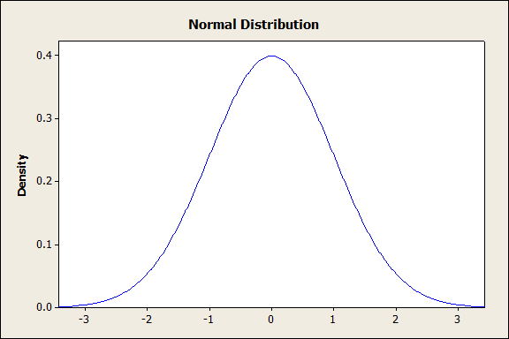
Continuous Distribution
Properties of Normal Distributions :
Characteristics of the normal distribution:
Continuous distribution - Line does not break
Bell-shaped, symmetrical distribution
Ranges from -∞ to ∞
Mean = median = mode
Area under the curve = total probability = 1
68% of data are within one std dev of mean, 95% within two std devs, and 99.7% within three std devs

Slide 69
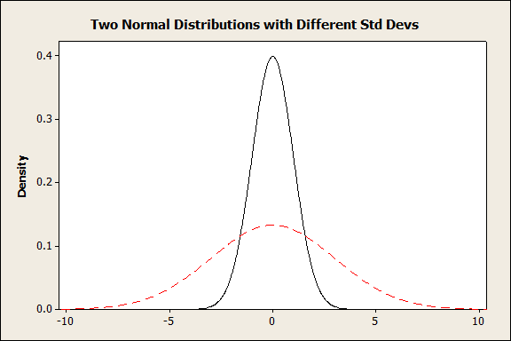
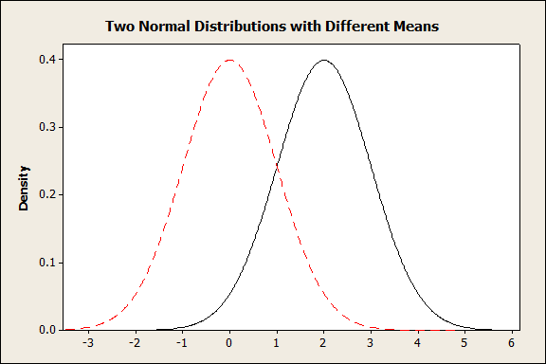
Continuous Distribution
Probability density function of Normal Distributions :
There are a number of different normal distributions, they are characterized by the mean and the standard deviation.

Slide 70
Continuous Distribution
Probability density function of Normal Distributions :
X

Slide 71
Continuous Distribution
Normal Distributions : Calculating Probabilities :
Rather than create a different table for every normal distribution (with different mean and std devs), we can calculate a standardized normal distribution, called Z
A z-score gives the number of standard deviations that a value x is above the mean.
Z distribution is normal distribution with a mean of 0 and a std dev of 1

Slide 72
Continuous Distribution
Standardised Normal Distributions :
Z distribution probability values are given in table or can be calculated using software
Table gives the total area under the Z curve between 0 and any point on the positive Z axis
Since the curve is symmetric, the area under the curve between Z and 0 is the same whether the Z curve is positive or negative

Slide 73
Continuous Distribution
Z Table :
.
Second Decimal Place in Z
Z 0.00 0.01 0.02 0.03 0.04 0.05 0.06 0.07 0.08 0.09
0.00 0.0000 0.0040 0.0080 0.0120 0.0160 0.0199 0.0239 0.0279 0.0319 0.0359
0.10 0.0398 0.0438 0.0478 0.0517 0.0557 0.0596 0.0636 0.0675 0.0714 0.0753
0.20 0.0793 0.0832 0.0871 0.0910 0.0948 0.0987 0.1026 0.1064 0.1103 0.1141
0.30 0.1179 0.1217 0.1255 0.1293 0.1331 0.1368 0.1406 0.1443 0.1480 0.1517
0.90 0.3159 0.3186 0.3212 0.3238 0.3264 0.3289 0.3315 0.3340 0.3365 0.3389
1.00 0.3413 0.3438 0.3461 0.3485 0.3508 0.3531 0.3554 0.3577 0.3599 0.3621
1.10 0.3643 0.3665 0.3686 0.3708 0.3729 0.3749 0.3770 0.3790 0.3810 0.3830
1.20 0.3849 0.3869 0.3888 0.3907 0.3925 0.3944 0.3962 0.3980 0.3997 0.4015
2.00 0.4772 0.4778 0.4783 0.4788 0.4793 0.4798 0.4803 0.4808 0.4812 0.4817
3.00 0.4987 0.4987 0.4987 0.4988 0.4988 0.4989 0.4989 0.4989 0.4990 0.4990
3.40 0.4997 0.4997 0.4997 0.4997 0.4997 0.4997 0.4997 0.4997 0.4997 0.4998
3.50 0.4998 0.4998 0.4998 0.4998 0.4998 0.4998 0.4998 0.4998 0.4998 0.4998

Slide 74
Continuous Distribution
Table lookup for standard normal probability:
.
Z 0.00 0.01 0.02
0.00 0.0000 0.0040 0.0080
0.10 0.0398 0.0438 0.0478
0.20 0.0793 0.0832 0.0871
1.00 0.3413 0.3438 0.3461
1.10 0.3643 0.3665 0.3686
1.20 0.3849 0.3869 0.3888
-3
-2
-1
0
1
2
3

Slide 75
Continuous Distribution
Applying Z formula :
.
Z 0.00 0.01 0.02
0.00 0.0000 0.0040 0.0080
0.10 0.0398 0.0438 0.0478
1.00 0.3413 0.3438 0.3461
1.10 0.3643 0.3665 0.3686
1.20 0.3849 0.3869 0.3888

Slide 76
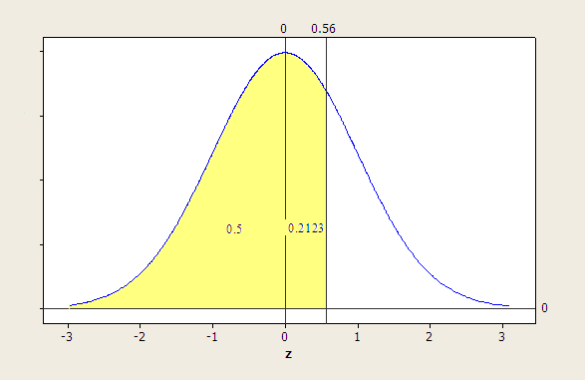
Continuous Distribution
Applying Z formula :
.
0.5 + 0.2123 = 0.7123

Slide 77
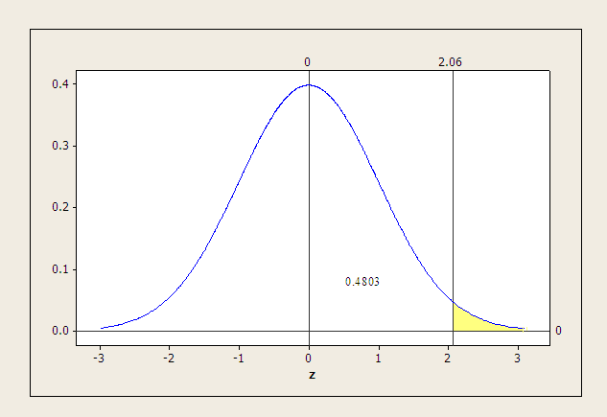
Continuous Distribution
Applying Z formula :
.
0.5 – 0.4803 = 0.0197

Slide 78
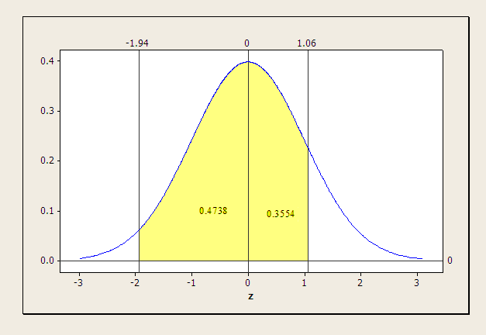
Continuous Distribution
Applying Z formula :
.
0.4738+ 0.3554 = 0.8292

Slide 79
Continuous Distribution
Normal Approximation of Binomial Distribution :
For certain types of binomial distributions, the normal distribution can be used to approximate the probabilities
- At large sample sizes, binomial distributions approach the normal distribution in shape regardless of the value of p
- The normal distribution is a good approximate for binomial distribution problems for large values of n

Slide 80
Continuous Distribution
Normal Approximation of Binomial Distribution : Parameter Conversion :
Conversion equations
Conversion example:
.

Slide 81
Continuous Distribution
Normal Approximation of Binomial Distribution : Interval Check :
0
10
20
30
40
50
60
n
70

Slide 82
Continuous Distribution
Normal Approximation of Binomial Distribution : Correcting for Continuity :
Values Being Determined
Correction
X>
X≥
X<
X≤
≤X≤
<X<
+.50
-.50
-.50
+.05
-.50 and +.50
+.50 and -.50

Slide 83
Continuous Distribution
Normal Approximation of Binomial Distribution : Binomial Computations :
X
P(X)
25
26
27
28
29
30
31
32
33
Total
0.0167
0.0096
0.0052
0.0026
0.0012
0.0005
0.0002
0.0001
0.0000
0.0361

Slide 84
Continuous Distribution
Exponential Distribution :
Another common continuous distribution is the exponential distribution
Example – the time until a light bulb works is known to follow an exponential distribution
It’s skewed to the right
Apex is always at X = 0
Steadily decreases as X gets larger

Slide 85
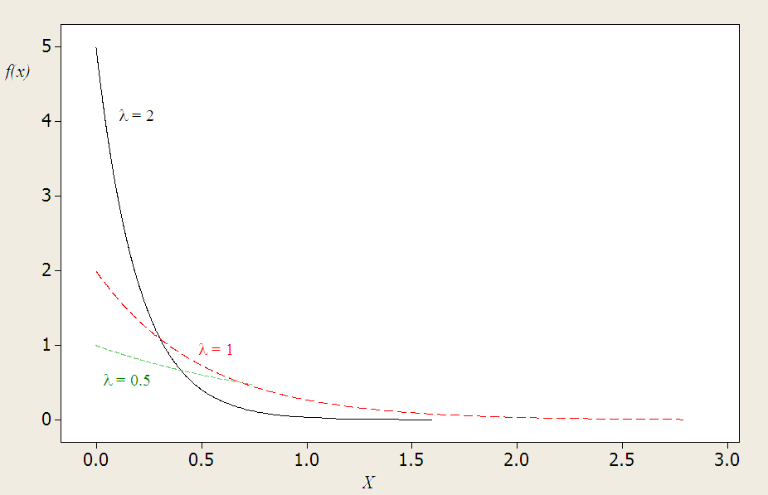
Continuous Distribution
Different Exponential Distributions :

Slide 86
Continuous Distribution
Exponential Distributions Probability Computations :
1.2
1.0
λ = 1.2
0.8
0.6
0.4
0.2
0.0
0
1
2
3
4
5

Slide 87
Continuous Distribution
Excercise :

